Slide 1

Medical Insurance Cost Predictor
Data Science Project Review-2
11/09/2026
 | Under the Guidance of Dr. N. Sunanda Associate Professor, Department of Computer Science and Engineering, KLH CSE Bowrampet Campus
Team Members U. Jaya Sindhura- 2420030044 K. Ushasri -2420030376 P. Smitha-2420030583

Slide 2
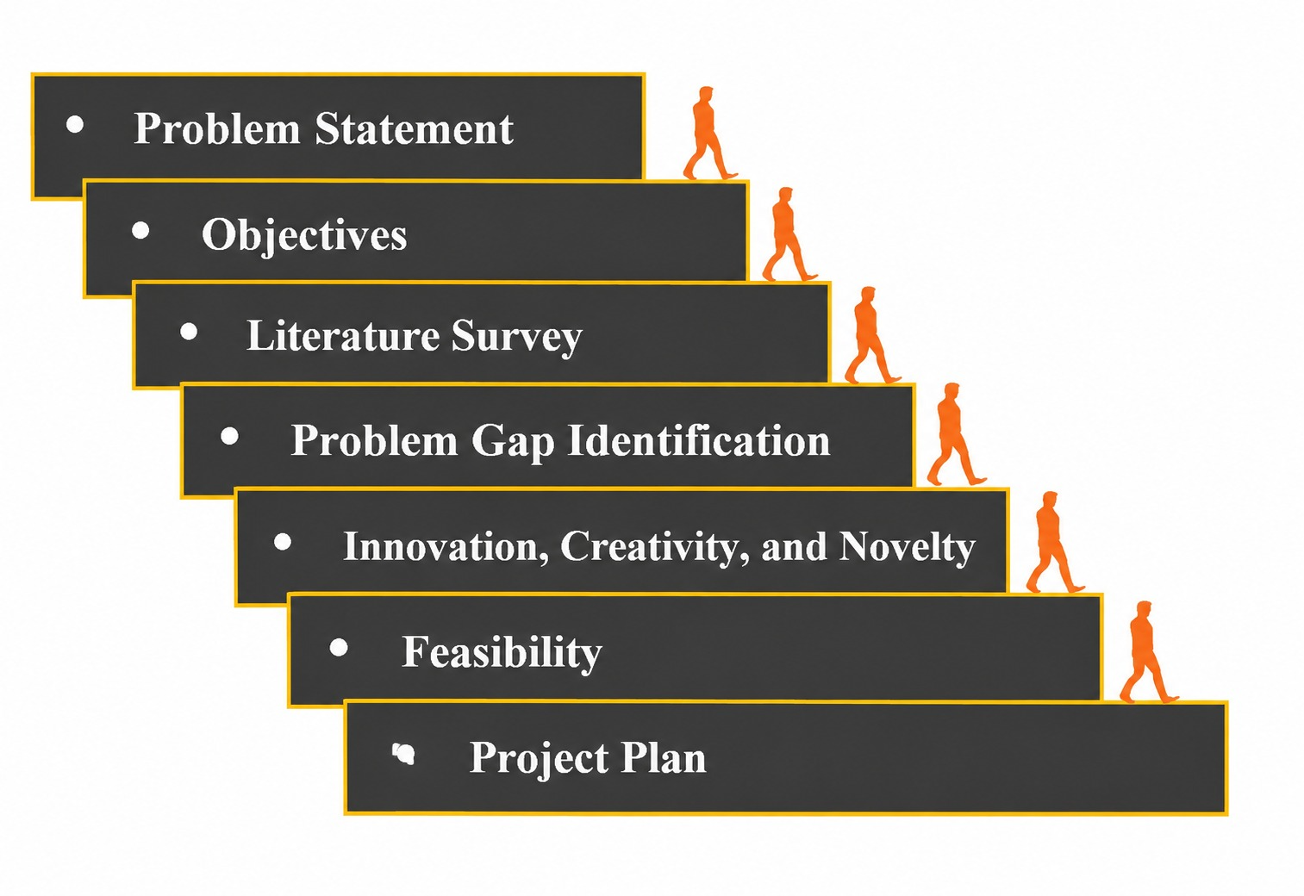
Outline of Project Work

Slide 3
Problem Statement
Medical insurance charges differ significantly among individuals.
The cost is influenced by multiple factors simultaneously.
Traditional estimation may not accurately capture these relationships.
Manual calculation of expected costs can be difficult and time-consuming.
There is a need for an automated, data-driven prediction system.
The proposed system predicts insurance charges using individual health and demographic information.

Slide 4
Objectives
Analyze the available medical insurance dataset.
Perform data preprocessing and cleaning.
Conduct Exploratory Data Analysis (EDA).
Identify the major factors influencing insurance charges.
Apply suitable regression algorithms.
Train and test the prediction models.
Evaluate model performance using MAE, MSE, RMSE and R² Score.
Identify the best-performing model for insurance cost prediction.

Slide 5
Literature Survey
Authors | Title of the Paper | Methodology | Inferences | Limitation/Future work
K. Kaushik et al. [1] | Machine Learning-Based Regression Framework to Predict Health Insurance Premiums | ANN-based regression, correlation analysis | Achieved 92.72% accuracy for health insurance premium prediction. | Can be further improved with advanced ML and larger datasets.
D. K. Kadali et al. [2] | Analysis and Prediction of Health Insurance Cost Using Machine Learning Approaches | Random Forest, Gradient Boosting, ML regression | ML models can effectively estimate health insurance costs. | More models and feature optimization can be explored.
Md. Samiuddin et al. [3] | Health Insurance Cost Prediction Using Deep Neural Network | Deep Neural Network | Uses personal and health-related features to predict insurance costs. | Deep learning requires more data and computational resources.

Slide 6
Problem Gap Identification
Medical insurance costs are affected by several interconnected factors.
Simple estimation methods may not consider all relevant features.
There is a requirement for accurate and automated cost estimation.
Different Machine Learning models may provide different levels of accuracy.
A comparative study of regression models can help identify a suitable prediction model.
The project addresses this gap through data analysis and regression-based prediction.

Slide 7
Innovation, Creativity, and Novelty
Innovation
Uses Machine Learning for medical insurance cost prediction.
Combines multiple health and demographic factors.
Provides data-driven cost estimation.
Creativity
Uses EDA and visualization to identify cost patterns.
Compares different regression models.
Provides an easy-to-understand predicted insurance cost.
Novelty
Integrates age, BMI, smoking status, children, gender, and region for prediction.
Identifies the key factors influencing insurance charges.
Can be extended into an interactive insurance cost prediction system.

Slide 8
Feasibility
Technical Feasibility
Python can be used for complete implementation.
Required ML libraries and tools are readily available.
Can be developed and tested on a standard computer.
Data Feasibility
Medical insurance dataset is publicly available.
Contains relevant health and demographic features.
Sufficient data is available for analysis and model training.
Economic Feasibility
Uses open-source tools and libraries.
No major additional software cost is required.
Project is cost-effective to implement.
Operational Feasibility
Provides a simple and user-friendly workflow.
Easy to use for insurance cost prediction.
Can be extended into a web-based application.

Slide 9
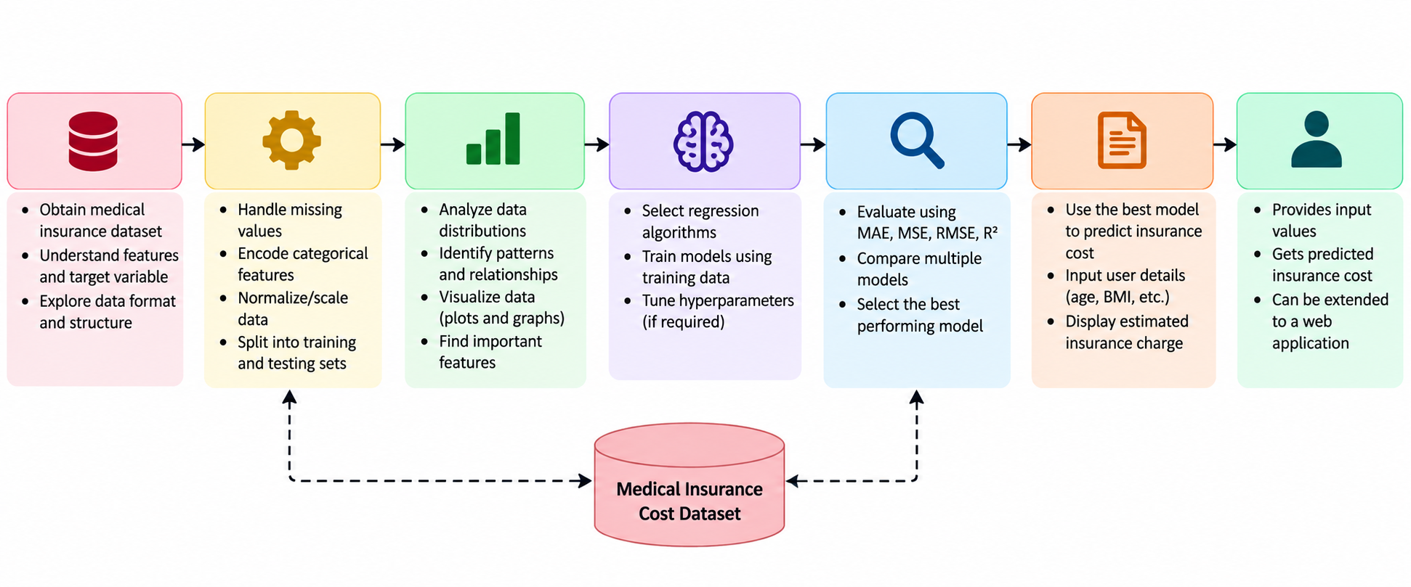
Project Plan

